Slide 1
Fundamental Data Types

Slide 2
Outline
Motivation
Integral (Integer) Types
Floating Point Numbers
Type Conversion
Back to the Original Example

Slide 3
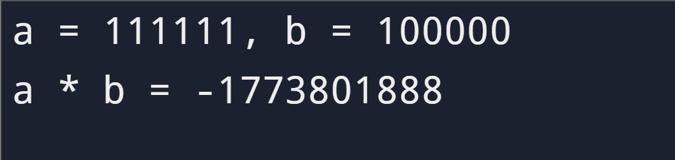
1. Motivation
Calculate the product
1
2
3
4
5
6
7
8
9
10
11
12
13
14
#include <stdio.h>
int main(void)
{
int a, b, p;
a = 111111;
b = 100000;
printf(“a = %d, b = %d\n", a, b);
p = a * b;
printf("a * b = %d\n", p);
return 0;
}

Slide 4
1. Motivation
Calculate the area of a triangle
1
2
3
4
5
6
7
8
9
10
11
12
13
14
#include <stdio.h>
int main(void)
{
int area, h, b;
h = 3;
b = 4;
printf("Height and base of triangle: %d, %d\n", h, b);
area = (1/2) * h * b;
printf("Area of triangle: %d\n", area);
return 0;
}
h
b

Slide 5

1. Motivation
This C program, however, does not produce the expected result. Why?! All the formula looks alright to you, right?
1
2
3
4
5
6
7
8
9
10
11
12
13
14
#include <stdio.h>
int main(void)
{
int area, h, b;
h = 3;
b = 4;
printf("Height and base of triangle: %d, %d\n", h, b);
area = (1/2) * h * b;
printf("Area of triangle: %d\n", area);
return 0;
}

Slide 6
1. Motivation
This C program, however, does not produce the expected result. Why?! All the formula looks alright to you, right?
1
2
3
4
5
6
7
8
9
10
11
12
13
14
#include <stdio.h>
int main(void)
{
int area, h, b;
h = 3;
b = 4;
printf("Height and base of triangle: %d, %d\n", h, b);
area = (1/2) * h * b;
printf("Area of triangle: %d\n", area);
return 0;
}
What if we declare the area as double?

Slide 7
1. Motivation
To understand the problem of the above program, you need to learn more about data types
In the previous lecture, we have introduced the integer data type:
int x = 0;
You may also recall a double data type:
double pi = 3.14;
How do they differ? Why do we need to have different data types?
Understanding data types thoroughly is a crucial first step of being a programmer in C

Slide 8
2. Integral (Integer) Types
Key concepts
The smallest/largest integer values of type int
Variation of integer types
Integer types of different sizes
Unsigned and signed integers
Integer overflow

Slide 9
2.1. Basic Building Block: bit, Byte
Ultimately, a computer represent data in bits.
A bit (binary digit) is the smallest unit data.
A bit can be either 0 or 1.
1 Byte == 8 bits
Computers use combination of bits to represent all sorts of data.

Slide 10
2.1. From Bits to Integers
Binary number system uses N bits to represent integers.
Typically, N = 8, 16, 32, 64 (corresponding to 1, 2, 4 and 8 bytes)
E.g. 8 bits represent one of 2⁸=256 different bit patterns:
00000000, 00000001, 00000010, 00000011, …, 11111110, 11111111
Some people assign each a non-negative integer value, 0, 1, 2, …, 254, 255.

Slide 11
2.1. From Bits to Integers (Negative Integer)
Some people rearrange the patterns in a different order:
10000000, 10000001, 10000010, 10000011, 10000100, 1000101, …, 11111110, 11111111, 00000000, 00000001, 00000010, …, 01111111
And call them -128, -127, -126, -125, …, -2, -1, 0, 1, 2,3, …, 125, 126, 127
The patterns are used for representing both –ve, 0 and +ve integers.
Left most digit: negative(1), non-negative(0)
8 bits: –128 to 127

Slide 12
2.1. From Bits to Integers
With N bits, we can represent 2^{N} distinct values.
Half for negative integers, and half for non-negative integers:
-(2^{N-1}), -(2^{N-1} - 1), …, -2, -1, 0, +1, +2, …, +(2^{N-1} - 1)
Type int is typically 32 bits in size nowadays. As such, it can represent integers in the following range
-(2³¹), -(2³¹ - 1), … , -2, -1, 0, +1, +2, …, +(2³¹ - 1)
or
-2147483648, …, -2, -1, 0, 1, 2, …, 2147483647

Slide 13
2.2. Variations of Integral Types (Can be different in different compilers)
Type | Size in bytes [In General] | Range
signed char | 1 | -128 to 127 (a signed byte)
short (or short int) | 2 | -2¹⁵ to 2¹⁵-1 (-32768 to 32767)
int | 4 | -2³¹ to 2³¹-1 (if 4 bytes)
long (or long int) | 8 | -2⁶³ to 2⁶³-1 (if 8 bytes)
unsigned char | 1 | 0 to 255 (an unsigned byte)
unsigned short | 2 | 0 to 2¹⁶-1 (0 to 65535)
unsigned int (or unsigned) | 4 | 0 to 2³²-1 (if 4 bytes)
unsigned long | 8 | 0 to 2⁶⁴-1 (if 8 bytes)
Notes:
For some compilers and some systems, such as Replit, the sizes of “long” and “unsigned long” are 8 bytes

Slide 14
2.2. Variations of Integral Types
What is the appropriate type to represent integers in this program?
When the amount of data to be processed is large and the memory space is scarce, we have to be mean.
For now it suffices to know that these variations of integral types exist. For most applications, using int is adequate.
Why are there so many different types of integers?

Slide 15
2.3. Integer Overflow
Integer overflow occurs when the result of an arithmetic operation is too large to be represented by the underlying integer representation.
1
2
3
4
5
6
7
8
9
10
11
12
13
14
#include <stdio.h>
int main(void)
{
int a, b, p;
a = 111111;
b = 100000;
printf(“a = %d, b = %d\n", a, b);
p = a * b;
printf("a * b = %d\n", p);
return 0;
}

Slide 16
2.3. Integer Overflow
Integer overflow occurs when the result of an arithmetic operation is too large to be represented by the underlying integer representation.
For 32-bit signed integer,
-(2³¹), -(2³¹ - 1), … , -2, -1, 0, +1, +2, …, +(2³¹ - 1)
or
-2147483648, …, -2, -1, 0, 1, 2, …, 2147483647
Add one to the largest signed positive integer:
2147483647 + 1 → –2147483648
The correct result +2147483648 is NOT representable in 32-bit signed integer representation, i.e. out of range.
We have to use another data type to represent such a number
0111…111 + 1 → 1000…000

Slide 17
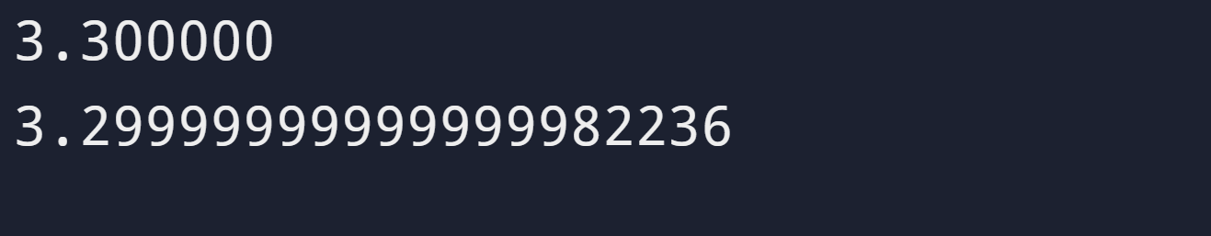
Outline
Motivation
Integral (Integer) Types
Floating Point Numbers
Type Conversion
Back to the Original Example
1
2
3
4
5
6
7
8
#include <stdio.h>
int main(void)
{
printf("%f\n", 3.3);
printf("%.20f\n", 3.3);
return 0;
}

Slide 18
3. Floating Point Numbers
Key Concepts
Floating point numbers representation and arithmetic are not exact.
[Advanced and Optional] Further Reading and Reference
IEEE 754 Standard for Floating-Point Arithmetic, Wikipedia (https://en.wikipedia.org/wiki/IEEE_754)
IEEE 754-2019 - IEEE Standard for Floating-Point Arithmetic (https://ieeexplore.ieee.org/document/8766229)

Slide 19
3.1. Floating Point Number Representation
Floating point numbers and integers have different representations.
Not all real numbers are representable.
Finite number of bits vs. infinitely many real numbers
Decimal to/from binary conversion error, e.g. convert 0.1 to binary
Floating-point number representation and arithmetic operations need not be exact.
e.g., printf("%.20f; %.20f", 3.3, 2.1 - 2.0 - 0.1);
yields 3.29999999999999982236; 0.00000000000000008327
For very large computations, rounding errors may accumulate and become significant.

Slide 20
3.2. Using floating point with printf()
Remember our example last time?
1
2
3
4
5
6
7
8
9
10
11
12
13
14
#include <stdio.h>
int main(void)
{
double pi = 3.1415927;
printf("A) %f\n", pi);
printf("B) %.2f\n", pi);
printf("C) %.7f\n", pi);
return 0;
}
A) 3.141593
B) 3.14
C) 3.1415927
The format specifier, %.xf, tells
printf() to format the corresponding floating point number with x decimal places.

Slide 21
3.2. Using floating point with printf()
You should now realize that integers and floating point numbers are completely different things in C language
You must specify correctly what data type you are supplying or you will see meaningless results
What do you think the result will be in the following example?
e.g. printf("%d", 3.14);

Slide 22
3.3. C Language Floating-Point Types
Type | Size [In general] | Range and Precision
float | 4 bytes 32-bit single-precision | Range: ±3.4 x 10^{± 38} Precision: 6 significant decimal places
double | 8 bytes 64-bit double-precision | Range: ±1.7 x 10^{± 308} Precision: 15 significant decimal places
long double | ≥ 8 bytes [16 bytes] | System dependent; may provide wider range and more precision
123.451234512345 is more precise than 123.451
For most applications, using double is recommended.
If possible, avoid using float which is imprecise in modern day standard, thus leading to loss of precision.
Notes:
#include <stdio.h>
int main(void)
{
float a=0.123456;
double b=0.123456;
printf("%.6f \n%.6f \n\n",a,b);
printf("%.15f \n%.15f \n\n",a,b);
printf("%.25f \n%.25f \n\n",a,b);
return 0;
}

Slide 23
3.4. Using floating point with scanf()
1
2
3
4
5
6
7
8
9
10
11
12
13
14
#include <stdio.h>
int main(void)
{
double r1, r2;
printf("Enter two real numbers:\n");
scanf("%lf%lf", &r1, &r2);
printf("r1 = %f\n", r1);
printf("r2 = %f\n", r2);
return 0;
}
Variables r1 and r2 are of type double
Concerning double-typed values,
scanf() uses %lf (‘ell’ f);
printf() uses %f.
Look similar but slightly different!
Enter two real numbers:
123 456.125↵
r1 = 123.000000
r2 = 456.125000
printf(), by default, prints decimal numbers (floating point numbers) with 6 decimal places.

Slide 24
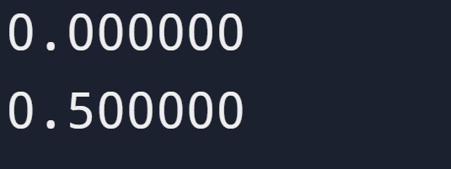
Outline
Motivation
Integral (Integer) Types
Floating Point Numbers
Type Conversion
Back to the Original Example
1
2
3
4
5
6
7
8
#include <stdio.h>
int main(void)
{
printf("%f\n", 1/2);
printf("%f\n", 1.0/2);
return 0;
}

Slide 25
4. Type Conversion
Key Concepts
How types are converted in an expression with mixed types of numbers
e.g., double a=2.5 + 5 / 2;
a=?
How a double type value is converted to an integral type value
Implicit Type Conversion
Explicit Type Conversion (Type Casting)

Slide 26
4.1. Expressions with mixed types of data
HK$1000 + US$100 = ?
3.1 + 2 = ?
double d = 4; What value will d hold?
int x = 4.1; What value will x hold?
Some kind of conversion is needed to ensure the type of both operands are compatible before the computer can evaluate the expressions.

Slide 27
4.1. Implicit Type Conversion
C language has a set of conversion rules to resolve certain mismatched operand types.
As a convenient to programmers, compilers automatically convert the value of an operand from one type to another based on these rules whenever possible.
Sometimes called coercion.

Slide 28
4.1. Arithmetic Conversions (Simplified Rules)
If either operand is a double, the other is converted to double. The result type is also double.
e.g.:
(1.0 is of type double)
(Therefore, 2 is converted to 2.0)
(Result is of type double)
If both operands are of one of the integral types char, short and int, then both operands are converted to int. The result type is also int.
1 / 2 = 0
1.0 / 2 = 0.5
Notes:
Detailed rules obtained from: https://learn.microsoft.com/en-us/cpp/c-language/usual-arithmetic-conversions
If either operand is of type long double, the other operand is converted to type long double.
If the above condition is not met and either operand is of type double, the other operand is converted to type double.
If the above two conditions are not met and either operand is of type float, the other operand is converted to type float.
If the above three conditions are not met (none of the operands are of floating types), then integral conversions are performed on the operands as follows:
If either operand is of type unsigned long, the other operand is converted to type unsigned long.
If the above condition is not met and either operand is of type long and the other of type unsigned int, both operands are converted to type unsigned long.
If the above two conditions are not met, and either operand is of type long, the other operand is converted to type long.
If the above three conditions are not met, and either operand is of type unsigned int, the other operand is converted to type unsigned int.
If none of the above conditions are met, both operands are converted to type int.

Slide 29
4.2. Converting Integral Type to double
Converting integral type to double is safe.
No warning is given at compile time
double d;
d = 4;
/* 4 is converted to 4.0,
and then 4.0 is assigned to d */

Slide 30
4.2. Converting double to Integral Type
Converting a double to an integral type may result in loss of data.
If the number is within the range of the integral type, the fractional part is truncated, i.e. discarded.
Compilers usually warn at compile time (but NOT guaranteed.)
int x = 4.1; /* 4.1 is converted to 4 */
x = 2 * 4.1; /* 8.2 is converted to 8 */
x = 92345678901.2; /* behaviour is undefined
when the value is too
large to hold in x */
How about
int x=4.9;

Slide 31
4.3. Explicit Type Conversion (Casting)
Syntax: (new_type) operand
Converts the value of operand to the equivalent value of type new_type.
(new_type) is called the type casting operator
Note that not every type conversion is possible, however.
e.g.,
double d = 4.2;
int y = (int) d; // y becomes 4, no warning
int x = d; // x becomes 4, compiler warns
// because of missing type casting

Slide 32
4.4. Type Conversion (Examples)
1
2
3
4
5
6
7
8
9
10
11
12
13
int x = 5, y = 2;
double a, b;
a = 2.5 + (x / y); /* R.H.S. is evaluated as
2.5 + (5 / 2)
=> 2.5 + 2
=> 2.5 + 2.0
=> 4.5 */
b = 2.5 + ((double)x / y); /* R.H.S. is evaluated as
2.5 + (5.0 / 2)
=> 2.5 + (5.0 / 2.0)
=> 2.5 + 2.5
=> 5.0 */
Example 4.1. Expression with mixed data types

Slide 33
4.4. Type Conversion (Examples)
1
2
3
4
int x, y;
double a = 2.6, b = 2.4;
x = (int)(a + 0.5); // x is assigned 3
y = (int)(b + 0.5); // y is assigned 2
Example 4.2. Rounding floating point numbers to nearest integer
How about
x=(int)a+0.5
y=(int)b+0.5

Slide 34
4.4. Using Type Casting Operators (Exercise)
Average of N integers
// Consider the following declaration
int total, N;
double avg;
…
// Suppose we have obtained the value of N and
// calculated the total of N integers.
// Which of these will correctly calculate the average?
avg = total / N; // A
avg = (double)total / N; // B
avg = total / (double)N; // C
avg = (double)(total / N); // D
avg = (double)total / (double)N; // E
Ureply
Notes:
Try 5/2 and 5./2 or 5/2.

Slide 35
4.5. How are numbers converted? (Apply to both implicit and explicit conversions)
double to integral types
Only retain the integer part (no rounding)
e.g.:
int x = (int) 4.9; // x gets 4
int y = (int) -3.99; // y gets -3
"Larger" integral types to "smaller" integral types
Retain only the least significant bits (LS-bit)
e.g.: 32-bit integer (int) to 16-bit integer (short)
00000000000000100000000000000011 = 131075₁₀
0000000000000011 = 3₁₀
short x = (short)131075; // x becomes 3
Notes:
#include <stdio.h>
int main(void)
{
int a = -3.9999999999999999;
double b=-3.9999999999999999;
printf("%d, %.20f",a,b);
}

Slide 36
5. Back to the Original Example
Given your understanding of data types now, what is wrong with our original example?
1
2
3
4
5
6
7
8
9
10
11
12
13
14
#include <stdio.h>
int main(void)
{
int area, h, b;
h = 3;
b = 4;
printf("Height and base of triangle: %d, %d\n", h, b);
area = (1/2) * h * b;
printf("Area of triangle: %d\n", area);
return 0;
}
How to correct it?

Slide 37
5. Back to the Original Example
Given your understanding of data types now, what is wrong with our original example?
1
2
3
4
5
6
7
8
9
10
11
12
13
14
#include <stdio.h>
int main(void)
{
int area, h, b;
h = 3;
b = 4;
printf("Height and base of triangle: %d, %d\n", h, b);
area = (1/2) * h * b;
printf("Area of triangle: %d\n", area);
return 0;
}
Are we using the proper type? Are these variables always integers?
How about this? What are we telling printf?
Does 1/2 give integer as result, or floating point? Should we use, say, 0.5 instead?

Slide 38
Summary
All number types have an intended purpose, precision, and range.
Choose a proper data type to represent data
Beware of and prevent overflow
Floating-point representation and arithmetic may not be exact.
Expressions with mixed types of data
Automatic and explicit type conversion
Number conversion (double to int)

Slide 39
Appendix: Finding out the size of an integer
1
2
3
4
5
6
#include <stdio.h>
int main(void) {
printf("size of int = %d bytes\n", (int) sizeof(int) );
return 0;
}
size of int = 4 bytes
sizeof(data_type) yields the number of bytes used to represent a value of type data_type (as unsigned long).
(int) explicitly converts the value to int.

Slide 40
Reading Assignment
C: How to Program, 8th ed, Deitel and Deitel
Appendix C Number Systems

Slide 41
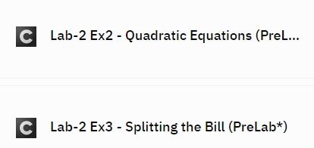
Reminder: PreLabs are Ready!
Every Mon afternoon we will release the PreLabs
Meant to help you prepare for the lab
Please try it after the lecture and submit before Thu.
Don't worry – it's super easy (takes < 30 min) and it helps to prepare your Lab! Don't forget!
Marked in "(PreLab)"
Not graded
Not Required

